Slide 1
Section 2. Selecting a Chart Type
Lection 4. Comparisons, ranking, Composition/Proportion
(column & bar charts, pie & donut charts)

Slide 2
General considerations
Data type
a bar or column chart is often an appropriate chart when we are summarizing data about categories.
The relationship between two quantitative variables often makes a scatter chart an appropriate choice.
Bar charts, scatter charts, and line charts with the horizontal axis being time, are often the best choice for time series data.
If your data have a spatial component, a geographic map might be a good choice.
…
The goal/insight
Explaining: the message that wish to convey
Exploring: the question you are asking
Common goals for charts are to show:
Comparison/Ranking— the relative order of items.
Composition/Proportions—make up the whole of an entity.
Correlation/Relationship— how two variables are related to one another.
Distribution— is how items are dispersed.
Creating great data visualizations is a skill that is best learned by doing

Slide 3
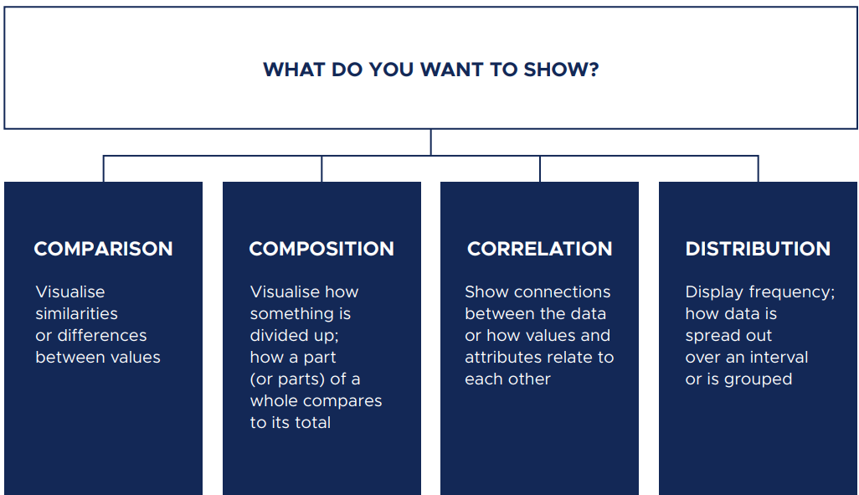

Slide 4
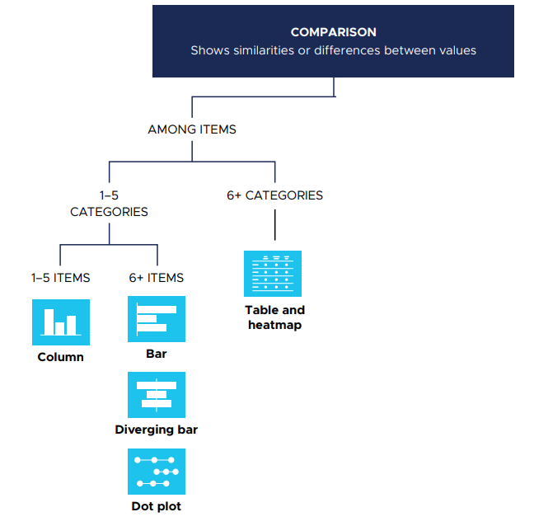

Slide 5
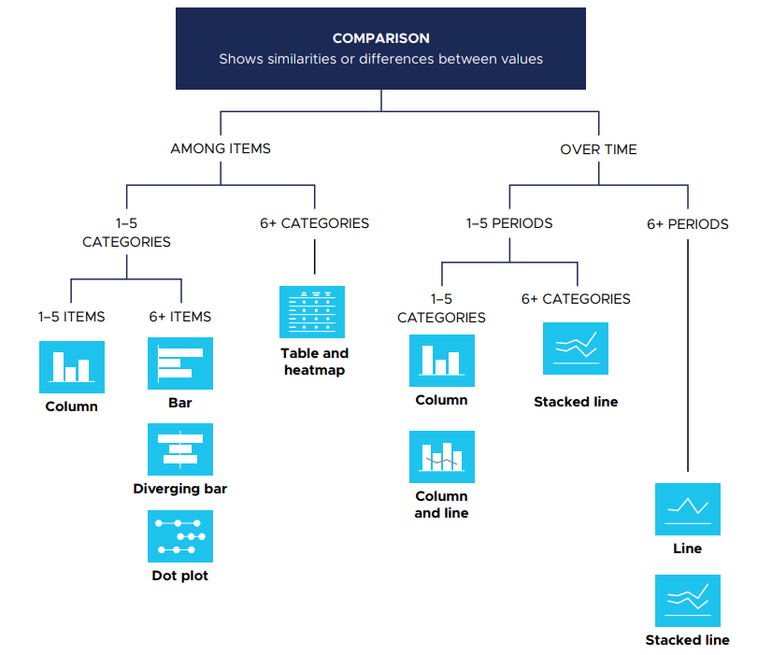

Slide 6
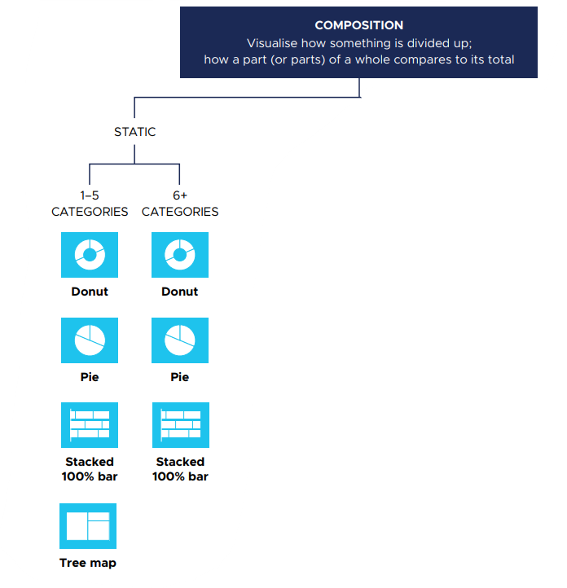

Slide 7
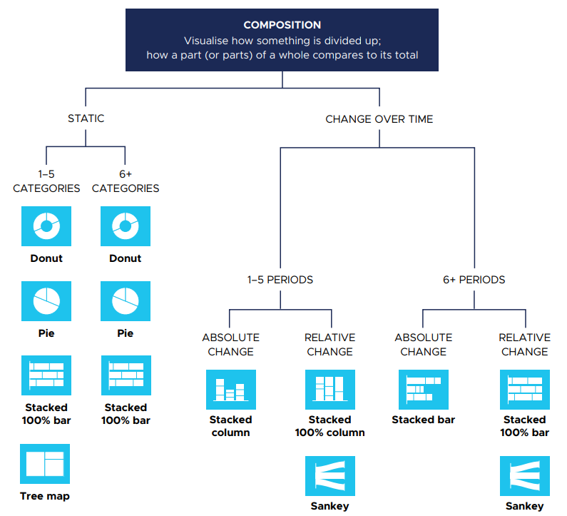

Slide 8
Data | Goal/Insight | Chart type | Example
Categorical | Comparisons, ranking, Composition/Proportion | Vertical bar, column bar, horizontal bar, bullet charts, Pie charts, Donut charts, group/clustered bars, stacked bar, stacked 100% bar, stacked area, stacked 100% area, and a tree map | Non-numeric data such as types of movies, books, or authors.
Univariate | Distributions, proportions, frequencies | Histogram, density plot, and a boxplot | One numeric variable, such as book price
Multivariate | Relationships, proportions, comparisons | Scatterplot, scatterplot matrix, bubble, parallel coordinates, radar, bullet, and a heat map | Two or more numeric variables, for example, weight, height, and IQ
Time series | Trends, comparisons, cycles | Line chart, sparkline, area, stream graph, as well as bubble, stacked-area, and vertical bar charts. | Years, months, days, hours, minutes, seconds, or date
Geospatial | Locations, comparisons, trends | Choropleth filled-map, bubble map, point map, connection map, and isopleth map | Specific locations marked by the latitude and longitude, regions coded by zip code, city, state, country, or county boundaries
Edge lists or adjacency matrices | Connections, relationships, tie strength, centrality, interactions, similarities | Undirected network diagram (graph) and directed network, Diagram | Who contacts whom or who knows whom in a network
Text | Sentiment, comparisons, frequency | Word cloud, proportional area chart using size bubbles or squares, histogram, and bar chart | Single words or phrases, such as keywords from restaurant reviews

Slide 9
Data | Goal/Insight | Chart type | Example
Categorical | Comparisons, ranking, proportions | Vertical bar, column bar, horizontal bar, bullet charts, Pie charts, Donut charts, group/clustered bars, stacked bar, stacked 100% bar, stacked area, stacked 100% area, and a tree map | Non-numeric data such as types of movies, books, or authors.
Univariate | Distributions, proportions, frequencies | Histogram, density plot, and a boxplot | One numeric variable, such as book price
Multivariate | Relationships, proportions, comparisons | Scatterplot, scatterplot matrix, bubble, parallel coordinates, radar, bullet, and a heat map | Two or more numeric variables, for example, weight, height, and IQ
Time series | Trends, comparisons, cycles | Line chart, sparkline, area, stream graph, as well as bubble, stacked-area, and vertical bar charts. | Years, months, days, hours, minutes, seconds, or date
Geospatial | Locations, comparisons, trends | Choropleth filled-map, bubble map, point map, connection map, and isopleth map | Specific locations marked by the latitude and longitude, regions coded by zip code, city, state, country, or county boundaries
Edge lists or adjacency matrices | Connections, relationships, tie strength, centrality, interactions, similarities | Undirected network diagram (graph) and directed network, Diagram | Who contacts whom or who knows whom in a network
Text | Sentiment, comparisons, frequency | Word cloud, proportional area chart using size bubbles or squares, histogram, and bar chart | Single words or phrases, such as keywords from restaurant reviews

Slide 10
Comparisons of Categories
Compare values or quantities either over time or to each other.
Questions: 1. What’s the best? What’s the worst? Compared to what?
2. Who’s ranked the highest? The lowest?
3. How does performance compare to the target or goal?
Goal/Insight: to illustrate the similarities and differences among categories (minimum, maximum, rank, performance, sum, totals, counts, and quantities).
Data: aggregated categorical data, time series data can be shown as a categorical variable.
Chart options: vertical bar, column bar, horizontal bar, and bullet charts.

Slide 11
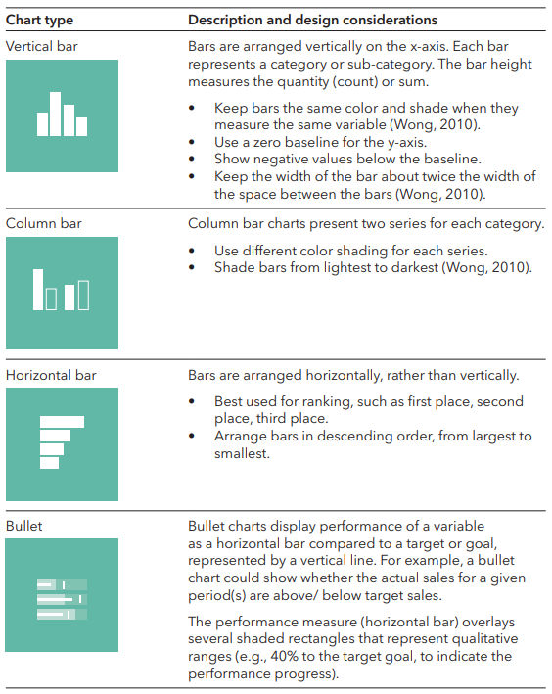
Charts for categories comparisons

Slide 12
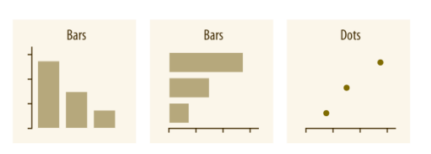
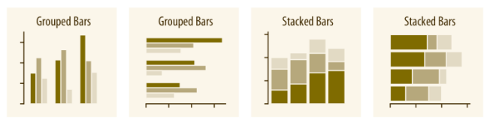
Amounts (for Comparison/Ranking)
The most common approach to visualizing amounts (i.e., numerical values shown for some set of categories) is using bars, either vertically or horizontally arranged. However, instead of using bars, we can also place dots at the location where the corresponding bar would end.
If there are two or more sets of categories for which we want to show amounts, we can group or stack the bars.

Slide 13
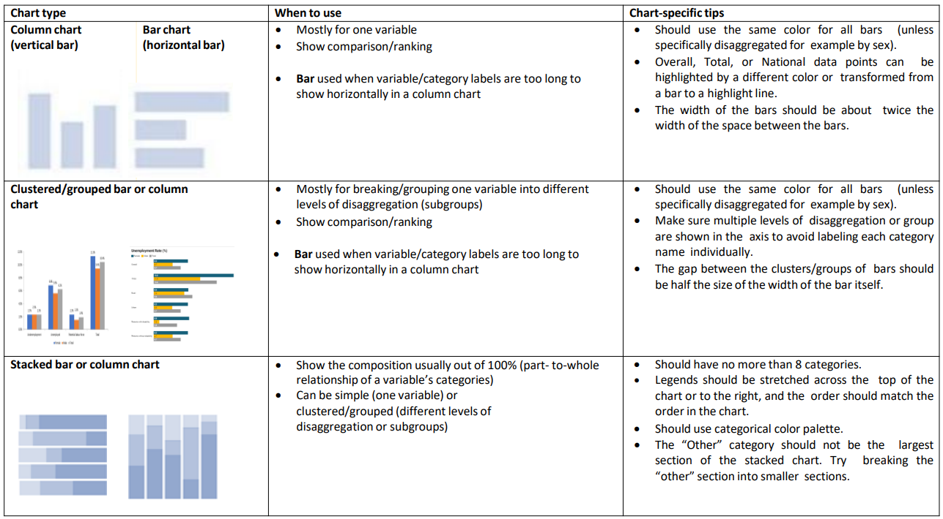
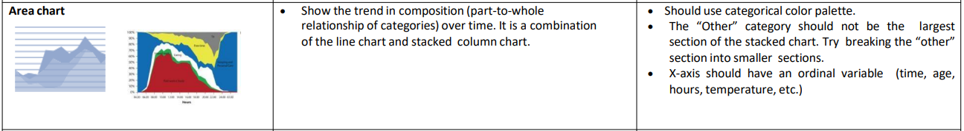

Slide 14
Composition/Proportions
Display individual parts of a whole
enables comparisons among subcategories by evaluating relative proportions, for example, demographics by neighborhood.
Questions: 1. What are the parts that make up the whole?
2. What part is the largest or smallest?
3. What parts are similar or dissimilar?
Goal/Insight: use to show summaries, similarities, anomalies, percentage related to the whole (by category, subcategory, and over time).
Data: single categorical variable with subcategories, two or more variables. A time dimension can also be included.
Chart options: pie, stacked bar, stacked 100% bar, stacked area, stacked 100% area, tree map, and doughnut chart.

Slide 15
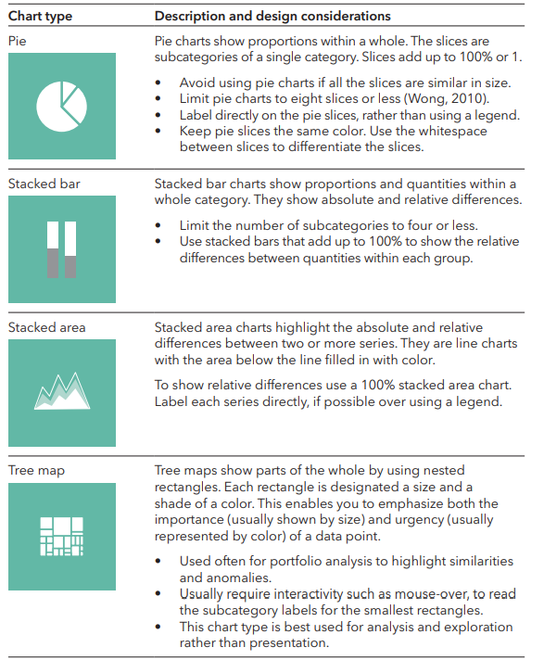
Charts for categories composition (Proportions)

Slide 16
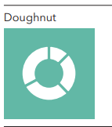
Charts for categories composition (Proportions)

Slide 17
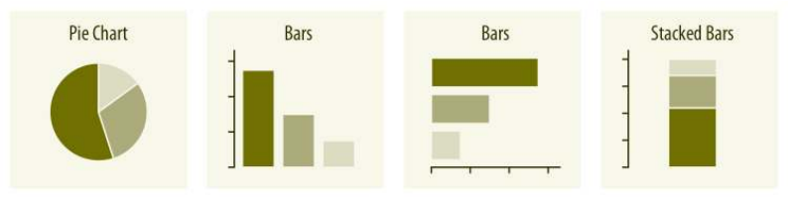
Composition/Proportions
Proportions can be visualized as pie charts, side-by-side bars, or stacked bars.
As for amounts, when we visualize proportions with bars, the bars can be arranged either vertically or horizontally.
Pie charts emphasize that the individual parts add up to a whole and highlight simple fractions. However, the individual pieces Proportions are more easily compared in side-by-side bars.
Stacked bars can be useful when comparing multiple sets of proportions

Slide 18
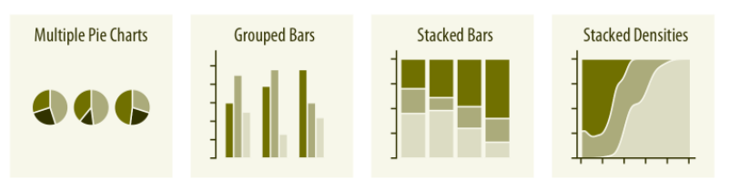
When visualizing multiple sets of proportions or changes in proportions across conditions, pie charts tend to be space-inefficient and often obscure relationships.
Grouped bars work well as long as the number of conditions compared is moderate, and stacked bars can work for large numbers of conditions.
Stacked densities are appropriate when the proportions change along a continuous variable.

Slide 19
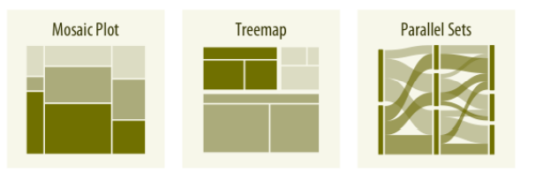
When proportions are specified according to multiple grouping variables, mosaic plots, treemaps, or parallel sets are useful visualization approaches.
Mosaic plots assume that every level of one grouping variable can be combined with every level of another grouping variable, whereas treemaps do not make such an assumption.
Treemaps work well even if the subdivisions of one group are entirely distinct from the subdivisions of another.
Parallel sets work better than either mosaic plots or treemaps when there are more than two grouping variables.

